Slide 1
Coordinates & transformations
DAY 02 OF 16 · 3D & 6DOF STREAMING
How to move, rotate and place 3D data, and how a 6DoF pose becomes one 4×4 matrix.
Points & frames
Translation
Rotation
4×4 matrices
Order matters
Quaternions
Book: Ch. 2 (mathematics) · Code: day02_coordinates_transforms/
Notes:
Today is the maths foundation for the rest of the course, but keep it concrete: every formula is printed by the lab script. Remind students of the 6 numbers from the playground. Today we turn those 6 numbers into a matrix that moves every point of a scene. The book’s Chapter 2 lists linear algebra as a fundamental resource; we use only the parts we need: vectors, matrices, and matrix multiplication.

Slide 2
Every 3D operation in this course is: multiply the points by a matrix.
THE BIG IDEA
Moving a scan, placing a camera, aligning two scans, rendering a view: all the same tool.
Day 02 · Coordinates & transformations
2
Notes:
Say the statement and promise that by the end of the class this will feel obvious. Mention where it shows up later: Day 6 (camera projection), Day 8 (ICP finds a matrix), Day 11 (the renderer uses the inverse pose), Day 15 (the browser does it 60 times per second).

Slide 3
A point only has coordinates relative to a frame
COORDINATE SYSTEMS
World frame
Object frame
Camera frame
Fixed reference for the scene. Our Python code: Z is up, units are metres.
Attached to a thing: the car’s front is its own +x.
Attached to the viewer. OpenCV: +z forward, x right, y down. three.js: −z forward, y up.
01
02
03
Day 02 · Coordinates & transformations
3
Notes:
Draw three sets of axes on the board: world, car, camera. Stress that (1, 2, 3) means nothing until you say in which frame. Two practical warnings: different tools use different conventions (LiDAR/GIS and Open3D are usually Z-up, three.js and Unity are Y-up), and handedness (right-handed vs left-handed) also differs; Unity is left-handed. The course code converts Z-up to Y-up with (x, y, z) → (x, z, −y) whenever data goes to the browser. Ask: why do you think a rendering engine prefers Y-up? (Screen y goes up in maths conventions; historical reasons.)

Slide 4
Moving = adding a vector; turning = multiplying by a matrix
TRANSLATION AND ROTATION
p’ = R · p + t
p
R
t
The point (x, y, z) we start with.
3×3 rotation matrix. Columns are the new axes. Rᵀ R = I, det R = 1.
Translation vector: how far to shift in x, y, z.
Day 02 · Coordinates & transformations
4
Notes:
Write the formula on the board too. Example with numbers from the lab printout: rotating [1, 0, 0] by 90 degrees about Z gives [0, 1, 0]: the x axis turns into the y axis. Explain the two properties that make a matrix a valid rotation: its transpose times itself is the identity (lengths and angles are kept) and its determinant is +1 (no mirroring). The lab checks both numerically. Ask: what does a matrix with determinant −1 do? It mirrors, which would turn a left glove into a right glove.

Slide 5
Pack R and t into one 4×4 matrix
HOMOGENEOUS COORDINATES
[x’ y’ z’ 1]ᵀ = [ R t ; 0 0 0 1 ] · [x y z 1]ᵀ
Why the extra 1?
Chaining
Undo
It lets translation be a multiplication too, so ANY chain of moves is one matrix product.
T_total = T₃ · T₂ · T₁ applies T₁ first.
T⁻¹ = [ Rᵀ −Rᵀt ; 0 0 0 1 ]
Day 02 · Coordinates & transformations
5
Notes:
This is the most important technical slide of the day. With 3 by 3 matrices you cannot express a translation as a multiplication; by adding a fourth coordinate equal to 1, you can. So any sequence of rotations and translations collapses into a single 4 by 4 matrix, and a GPU can apply it to millions of points at once. Read the product right to left: T3 times T2 times T1 applies T1 first. Show the inverse formula: it is cheap, no general matrix inversion needed, which is part of Lab L1.

Slide 6
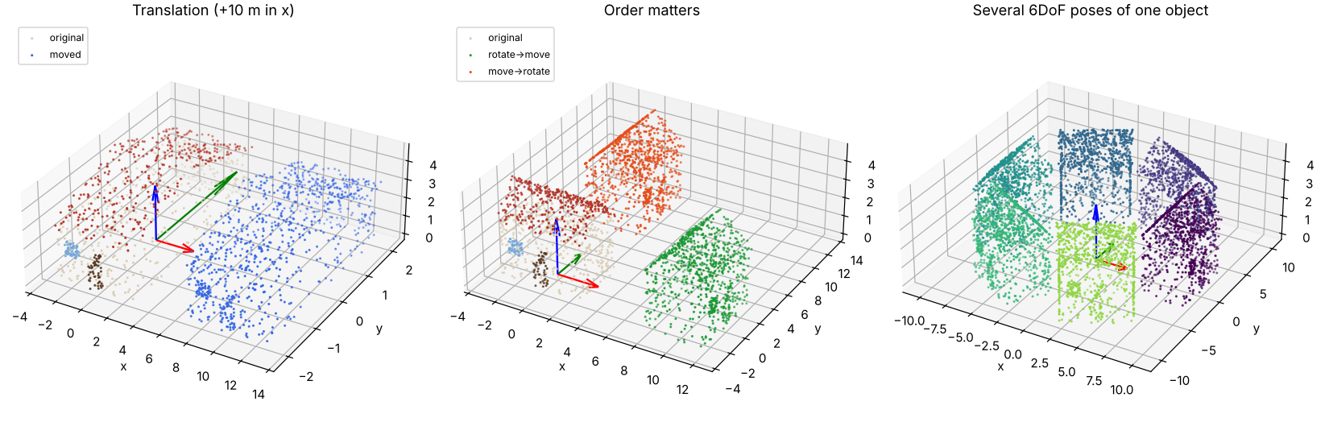
Order matters: rotate→move ≠ move→rotate
LAB PREVIEW
From transforms.py. Middle: the same two operations in a different order land the house in different places.
Day 02 · Coordinates & transformations
6
Notes:
Point at the middle panel: green is rotate-then-move, red is move-then-rotate. The script prints the two centres: about (10, 0) versus (0, 10). Why? If you move first, the rotation then swings the house around the world origin like a door on a hinge. The right panel shows six different 6DoF poses of the same object; each one is a single 4x4 matrix. Ask: in a game engine, an object is usually rotated around its own centre. Which order does that correspond to? Answer: rotate in the object frame, then translate to its place.

Slide 7
6 numbers → one matrix → 7 numbers on the wire
THE 6DOF POSE
Euler angles
Rotation matrix
Quaternion
yaw, pitch, roll. Easy for humans; suffers from gimbal lock and order ambiguity.
9 numbers, no ambiguity, ideal to apply to points.
4 numbers (w, x, y, z), smooth to interpolate. Engines and protocols send poses as position(3) + quaternion(4).
01
02
03
Day 02 · Coordinates & transformations
7
Notes:
Explain why there are several ways to store a rotation. Euler angles depend on the order in which you apply them (our code uses Z-Y-X, yaw then pitch then roll) and lose a degree of freedom when pitch is plus or minus 90 degrees (gimbal lock). Matrices are unambiguous but use 9 numbers for 3 degrees of freedom. Quaternions use 4 numbers, interpolate smoothly (slerp), and are what WebXR, OpenXR and game engines use. The lab prints the quaternion of a 45-degree yaw: (0.924, 0, 0, 0.383). A pose message is therefore 7 floats, 28 bytes: tiny compared to the content we will stream.

Slide 8
Print every step of the maths
HANDS-ON LAB · COPY, RUN, LOOK
RUN IT
cd day02_coordinates_transforms
python transforms.py
→ Check R.T @ R = I and det(R) = 1 in the printout.
→ Compare the two centres for the two orders.
→ Find the quaternion line: 7 floats per pose.
Day 02 · Coordinates & transformations
8
Notes:
Students run one script and read its printout top to bottom, then open outputs/transforms.png. Then give them the try-this tasks from the folder README: rotate 45 degrees about X and see where up goes; verify the inverse formula numerically; write quat_to_R. Fast students can start Lab L1 question 3 (pose matrix and its inverse without np.linalg.inv). 30 minutes.

Slide 9
Three things to remember
1
Coordinates are relative to a frame. Know your axes: Z-up in Python, Y-up in three.js.
2
A 4×4 homogeneous matrix holds rotation + translation; chains of moves are one product.
3
A 6DoF pose travels as 7 floats: position + quaternion.
BEFORE NEXT SESSION
Finish Lab L1 (Days 1–2). Install the course environment if you haven’t: next session we write a full 3D program.
Day 02 · Coordinates & transformations
9
Notes:
Recap. Remind them that Lab L1 is due before Day 3. Preview: next time we load a real point cloud file in Python, analyse its attributes and export it, following Chapter 3 of the book step by step.

